Slide 1

Machine learning: Random forests
Notes:
Note to self; this should come after they have seen ROC curves
NOTE: ROC curves are also valid only when you have two classes
1

Slide 2
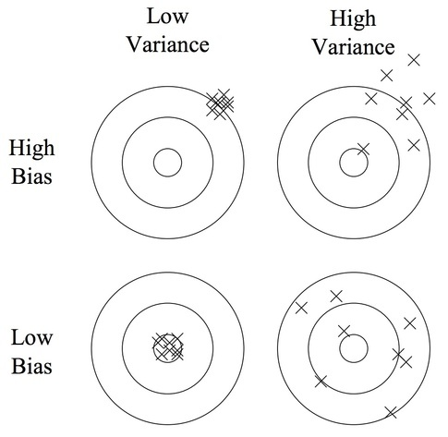
Over-fit, variance/bias dilemma

Slide 3
Regression trees
if Predictor B >= 80 then
if Predictor A >= 200 then dependent measure is 56
else dependent measure is 78
else dependent measure is 42

Slide 4
Regression trees
B
if Predictor B >= 80 then
if Predictor A >= 200 then dependent measure is 56
else dependent measure is 78
else dependent measure is 42
78
56
80
42
200
A

Slide 5
Categorization trees
B
if Predictor B >= 80 then
if Predictor A >= 200 then dependent measure is class 1
else dependent measure is class 2
else dependent measure is class 2
Class 2
Class 1
80
Class 2
200
A

Slide 6
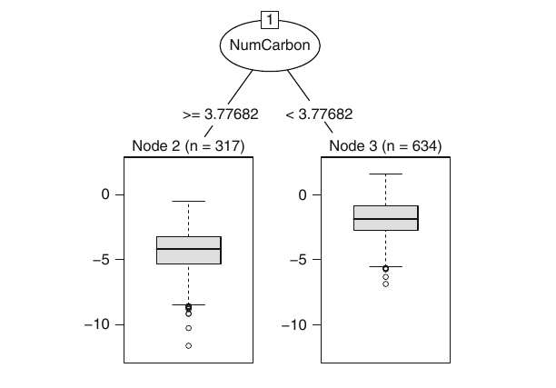
Trees

Slide 7
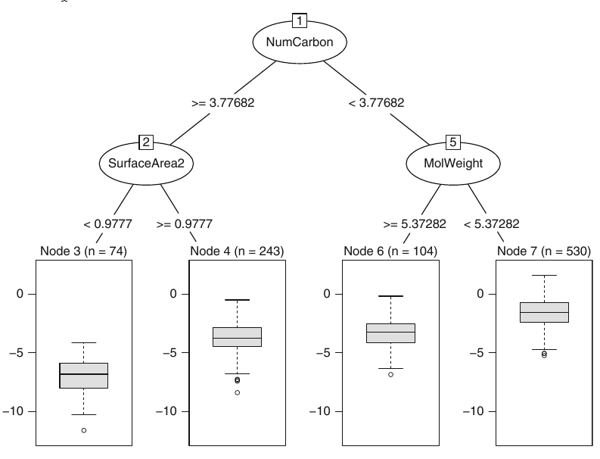
Trees
Notes:
the tree may be very large and is likely to over-fit the training set. The tree is then pruned back
1

Slide 8
Problems with decision trees
Single regression trees are more likely to have sub-optimal predictive performance compared to other modeling approaches
Decision boundaries are linear, trouble if your data is not linearly separable
An individual tree tends to be unstable
If the data are slightly altered, a completely different set of splits might be found
Selection bias: predictors with a higher number of distinct values are favored

Slide 9
Solution
Generating bootstrap samples introduces a random component into the tree building process

Slide 10


Slide 11
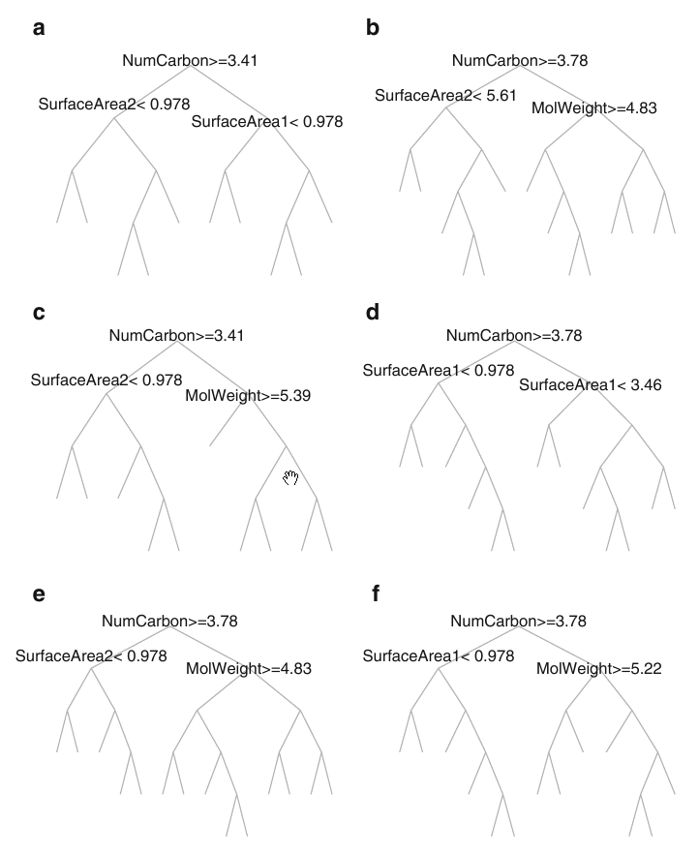
Bagging
Boostrapping and Aggregating (B-Agg-ing)

Slide 12
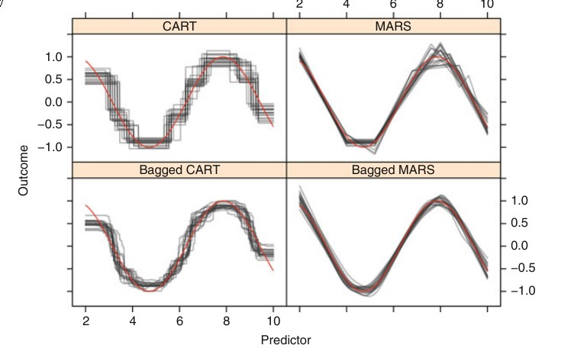

Slide 13

Ensemble Methods Foundations and Algorithms

Slide 14
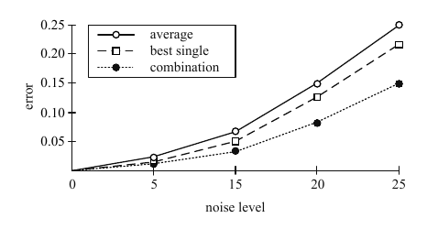
Hansen and Salamon (1990)’s observation: Ensemble is often better than the best single

Slide 15


Slide 16
Switch to detailed slides

